Slide 1
Meeting 30

Slide 2
Agenda
A bug in amount model
Re-run the optimization
Run optimization with occurrence parameters only
Look into rainfall and runoff behaviors
Schedule of meeting

Slide 3
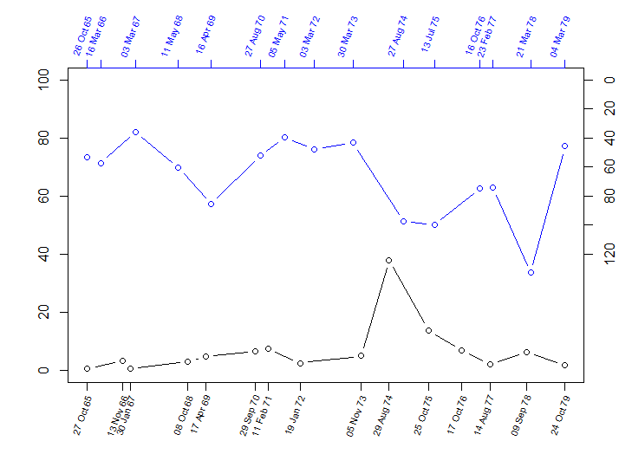
Annual Maxima Rainfall (1965-1979)
Runoff (mm)
Rain (mm)
Obs Rain
Vir.Obs. Runoff
Annual Maxima Runoff (1965-1979)

Slide 4
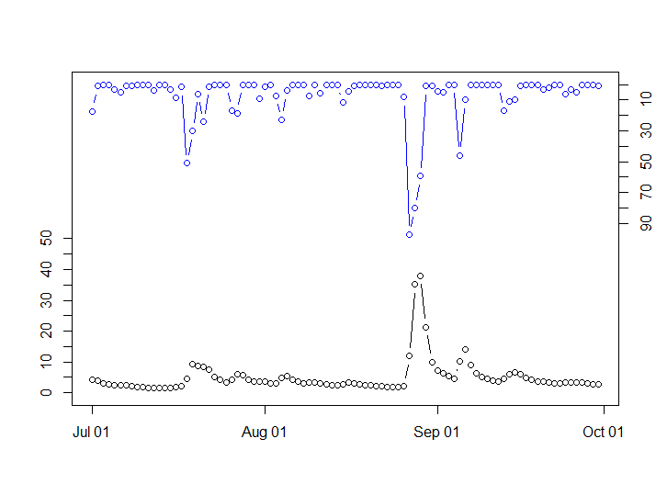
Daily Rainfall (01 July 1974 – 30 Sep 1974)
Obs Rain
Runoff (mm)
Vir.Obs Runoff
Rain (mm)
Daily Runoff (01 July 1974 – 30 Sep 1974)

Slide 5
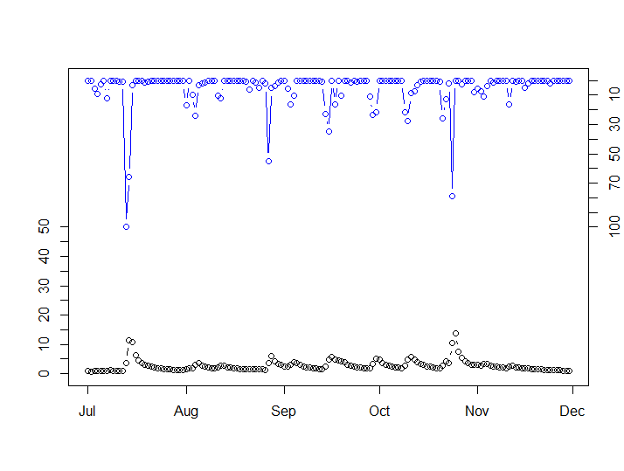
Daily Rainfall (01 July 1975 – 30 Nov 1975)
Runoff (mm)
Rain (mm)
Obs Rain
Vir.Obs. Runoff
Daily Runoff (01 July 1975 – 30 Nov 1975)

Slide 6
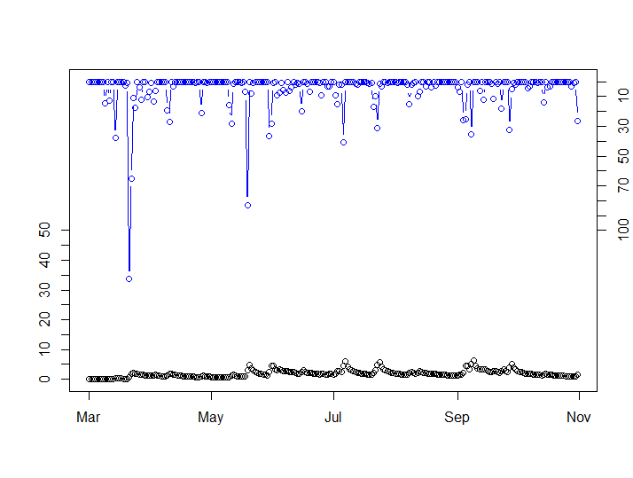
Daily Rainfall (01 Mar 1978 – 31 Oct 1978)
Runoff (mm)
Rain (mm)
Obs Rain
Vir.Obs. Runoff
Daily Runoff (01 July 1978 – 31 Oct 1978)

